Slide 1
Chapter 10
Creating Interactivity with CSS and JavaScript

Slide 2
Chapter Objectives
You will have mastered the material in this chapter when you can:
Use the CSS transform property
Create animations with CSS keyframes
Understand JavaScript
Describe JavaScript code
Understand and use the script element
Understand where JavaScript code may be written

Slide 3
Chapter Objectives (continued)
Create an external JavaScript file
Create JavaScript functions
Understand events
Use an onclick event handler

Slide 4
Introduction
Most modern websites include some form of interactivity
Commonly integrated within a website using CSS and JavaScript, a web programming language used to enhance a website and create interactivity
An effective way to create interesting and useful webpages is to include dynamic content to make the webpage interactive

Slide 5
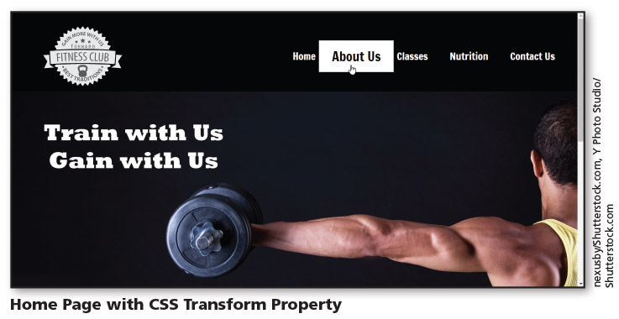
Introduction (continued 1)
Figure 10-1

Slide 6

Introduction (continued 2)
Figure 10-2

Slide 7

Introduction (continued 3)
Figure 10-3

Slide 8
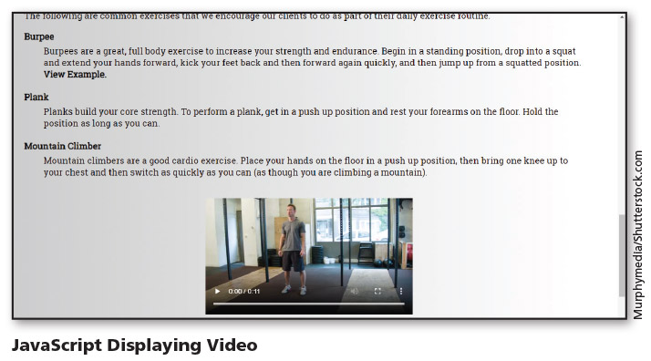
Introduction (continued 4)
Figure 10-4

Slide 9
Project — Add Interactivity to a Webpage
Roadmap
Create CSS transform
Create CSS animation
Create a hamburger menu
Create a JavaScript file
Create and call JavaScript functions

Slide 10
Using CSS to Create Interactivity
CSS began as a simple way to add color and design a webpage
Today, it has evolved to become so much more
Can be used to move elements on a webpage, change the color of an element, or change the appearance of an element

Slide 11
Using CSS to Create Interactivity (continued 1)
CSS transform property allows you to rotate, scale, skew, or translate a block element
Refer to Table 10–1 for methods that can be used with the transform property

Slide 12
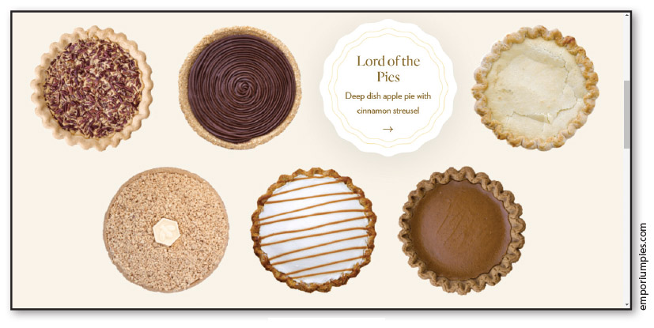
Using CSS to Create Interactivity (continued 2)
Figure 10–5

Slide 13
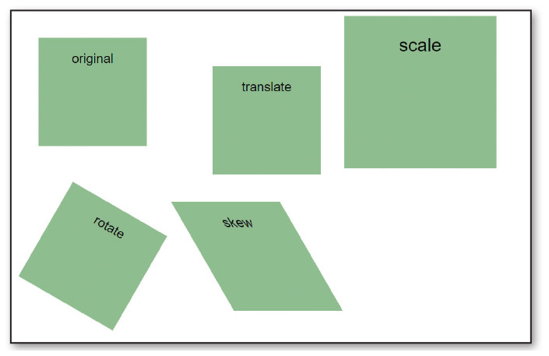
Using CSS to Create Interactivity (continued 3)
Figure 10–6

Slide 14
Incorporating JavaScript
JavaScript
Scripting language that provides various types of functionality to webpages, such as the ability to interact with the user
Web developers use it to control webpages
Client-side scripting language: browser interprets and renders the JavaScript

Slide 15

Incorporating JavaScript (continued 1)
Figure 10–16

Slide 16
Incorporating JavaScript (continued 2)
Many mobile websites integrate an icon commonly called the hamburger icon for use as a menu button
Consists of three, horizontal, parallel lines and uses JavaScript to display a menu and allow users to select an option

Slide 17
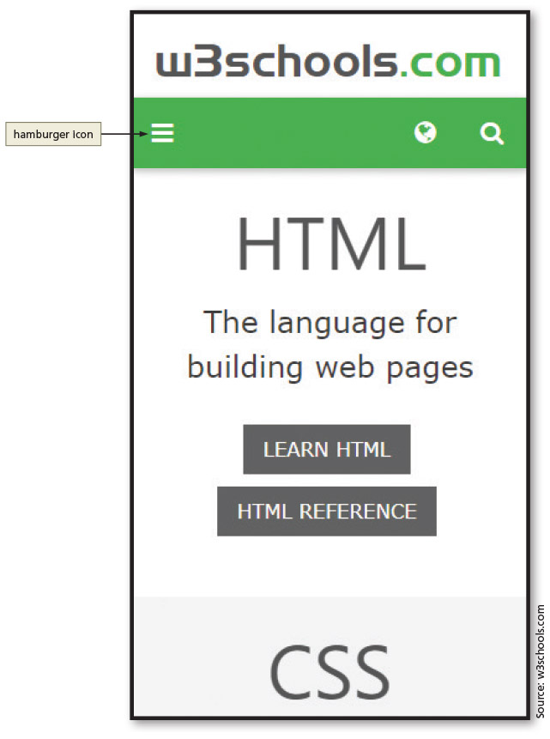
Incorporating JavaScript (continued 3)
Figure 10–17

Slide 18
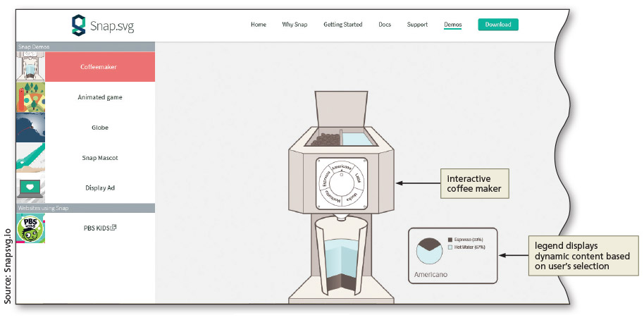
Incorporating JavaScript (continued 4)
Figure 10–18

Slide 19
JavaScript Terminology
To use JavaScript effectively, you should be familiar with its basic terminology
Statement: line of programming instructions to be executed by the client (the browser)
Object: programming code and data that can be treated as its own entity
Properties: attributes that describe an object’s characteristics
Methods: actions that an object can perform

Slide 20
JavaScript Terminology (continued 1)
Argument: value given to a method
Function: set of JavaScript statements that perform a specific task
Variable: container that holds a value
Event handler: used by JavaScript to associate an action with a function

Slide 21
Writing JavaScript Code
Syntax rules and guidelines should be followed when writing JavaScript code
JavaScript is case sensitive
One-line comment and multiline comments are written as follows:
// Single line comment syntax
/* Multiple line comment syntax */
Semicolons are used to end JavaScript statements

Slide 22
Writing JavaScript Code (continued 1)
JavaScript can be written within an HTML page or as a separate JavaScript file with the filename extension .js
When written within an HTML page, the code may be within the head element or the body element
When created as an external .js file, a script element is placed in the head element of the HTML file to specify the external .js file as the file source, as follows:
<script src="scripts/myfunction.js"></script>

Slide 23
DOM Methods
DOM stands for Document Object Model
Every element on an HTML page is an object
HTML DOM consists of all the HTML elements, attributes, and text
Together, all of these items are objects on the page

Slide 24
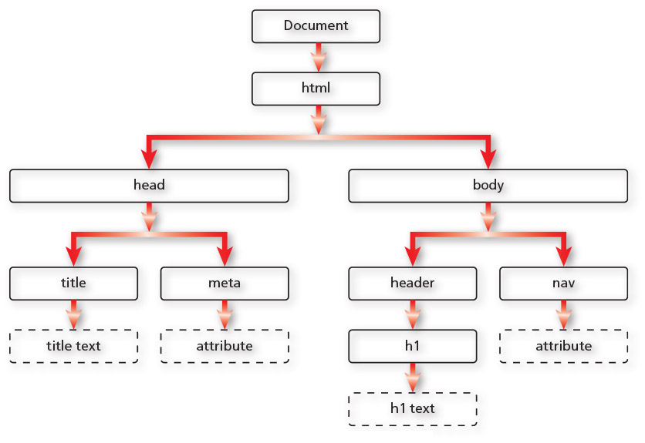
DOM Methods (continued 1)
Figure 10–42

Slide 25
DOM Methods (continued 2)
Method | Description
getElementsByClassName( ) | Returns all HTML elements with the specified class name
getElementsByName( ) | Returns all HTML elements with the specified name value attribute
getElementsByTagName( ) | Returns all HTML elements with the specified tag name
querySelector( ) | Returns the first HTML element with the specified CSS selector
querySelectorAll( ) | Returns a list of all HTML elements with the specified CSS selector
Table 10-4: DOM Methods

Slide 26
DOM Methods (continued 3)
Each item in the DOM tree is also known as a node
Any of these objects can be accessed using JavaScript DOM methods
Using a DOM method, you can use JavaScript to manipulate an HTML element

Slide 27
Using if/else Statements
Common JavaScript statement used within a function that assesses a specified condition
Condition is true: a specific block of code is executed
Condition is false: a different block of code is execute

Slide 28
jQuery
Commonly used library
JavaScript library that can significantly reduce the amount of code (and time) needed to complete a web project

Slide 29
Chapter Summary
In this chapter, you learned how to:
Integrate interactivity using CSS and JavaScript
Use the CSS transform property
Create animations with CSS keyframes
Create a JavaScript file and write JavaScript functions
Use event handlers to call JavaScript functions

